Slide 1
Spatio Temporal PM2.5 concentration prediction
Using convolution long short-term neural network
Group Members :
Kannuru Dinesh
P.Sai sree Ram
Sasikanth Rayaprolu
Group Number : MT02

Slide 2
Overview
Introduction
Problem Statement
Literature
Data
Methodology
Network architecture
Comparison
Model Front end design
Plan
References

Slide 3
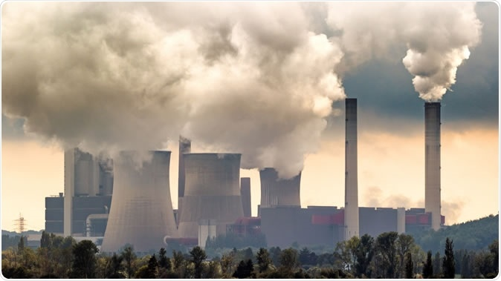
Introduction
Predicting air pollution in advance has great significance on people’s daily health control and government decision-making.
Existing methods have failed to effectively extract the spatiotemporal features of air pollution data, and exhibited low precisions in long-term predictions and sudden changes in air quality.

Slide 4
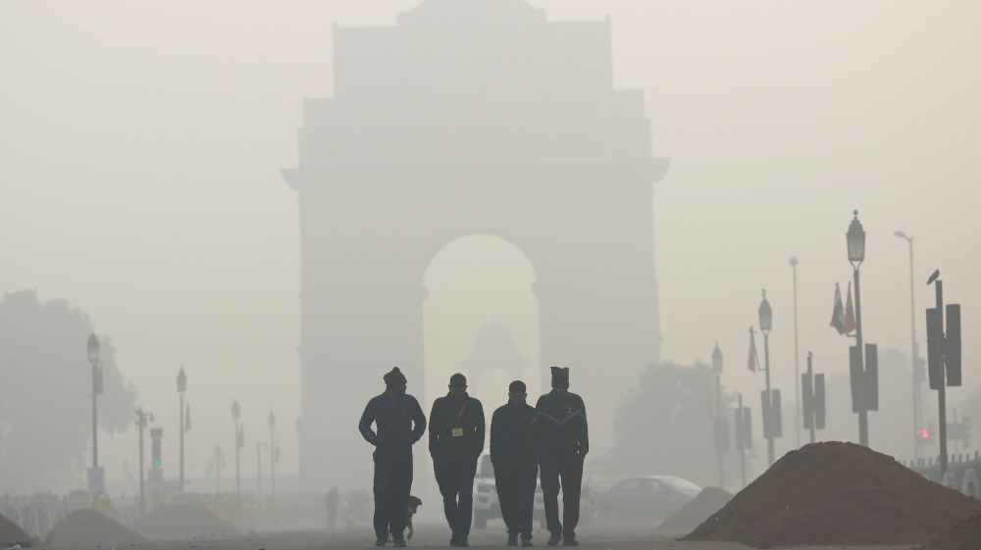
Problem Statement
A large number of epidemiological studies have demonstrated that PM2.5 can cause negative health effects, such as respiratory diseases.
Therefore, predicting air pollutant concentration in advance is fundamental to strengthen air pollution prevention and achieve comprehensive environmental management.

Slide 5
Literature
Previously, researchers used deterministic methods which like Community Multi-scale Air Quality (CMAQ) model (J. Chen et al., 2014), are based on aerodynamic theory and physicochemical process.
These deterministic models require very informative source data that are difficult to obtain in practice which resulting in limited accuracy.
Nowadays, statistical prediction methods have received increasing attention.

Slide 6
Literature Continued..
Deep Learning methods which are proposed in recent years include The Recurrent Neural Network(RNN)(Feng et al., 2011), Elman Neural Network, Time Delay Neural Network(TDNN).
X. Li et al. (2017) proposed the long short term memory neural network extended (LSTME) model.
Soh et al. (2018) proposed the spatio-temporal deep neural network (ST-DNN) model which integrates the long short term memory (LSTM) model to extract temporal features.

Slide 7
Data
Hourly Data of PM2.5 concentration along with other auxilary data like windspeed and humidity for 29 stations across Delhi are taken in the range 01-01-2019 to 31-12-2019
The Data is taken from Central Control Room for Air Quality Management - All India(ccr)
Since the data is huge we have used selenium to scrap the data from the above mentioned site.

Slide 8
Handling Null values
Sequential Gaussian simulation is used to handle null values
First,semivariogram is calculated using the 29 stations’ locations(lat,long)
Then the original data is transformed to normal data with zero mean and unit variance.
A simulation grid is created and the transformed data is assigned into it

Slide 9
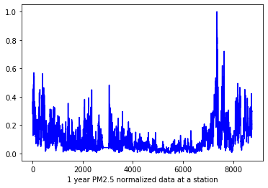
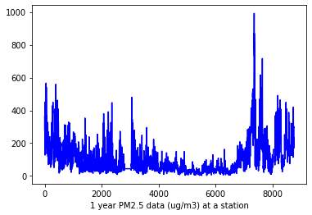
Data Summary
These graphs represent the hourly PM2.5 concentration (before and after normalization) of a station in delhi from january to december 2019.
90% of data is used for training and 10% for testing

Slide 10
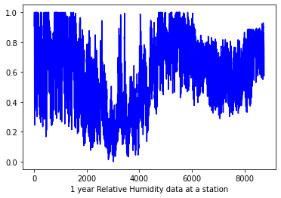
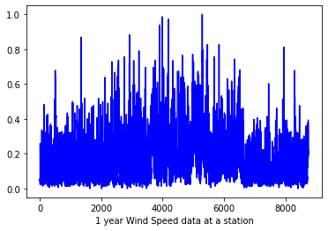
Auxiliary Data
The model is integrated with auxiliary data such as humidity, wind speed to improve the accuracy.
These plots represents the normalized data of humidity and wind speed of a station.

Slide 11
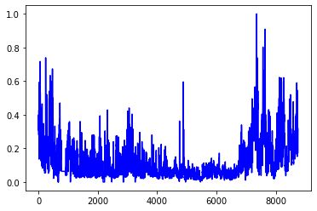
Neighbouring Stations Data
The neighbouring distributions of each station is fully considered, which means that k-nearest neighbouring stations were adaptively selected for each station.
These Graphs represent PM2.5 concentration of two neighbouring stations.

Slide 12
Methodology of LSTME
The input is a 2-D matrix contains normalized PM2.5 concentration data of dimensions N*r(N= n.o of stations ,r= The time lag ).
1st layer is stacked LSTM layers.
Next layer is a Fully connected layer .
Auxiliary data is added to Fully connected layer
The output is predicted PM2.5 concentration data.

Slide 13
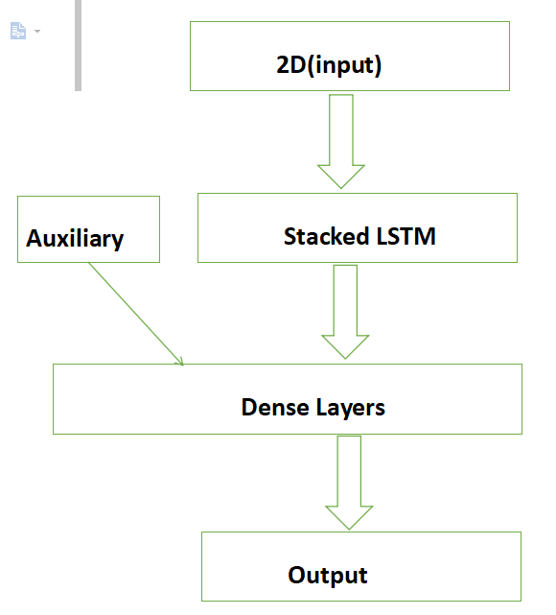
Network architecture LSTME Model

Slide 14
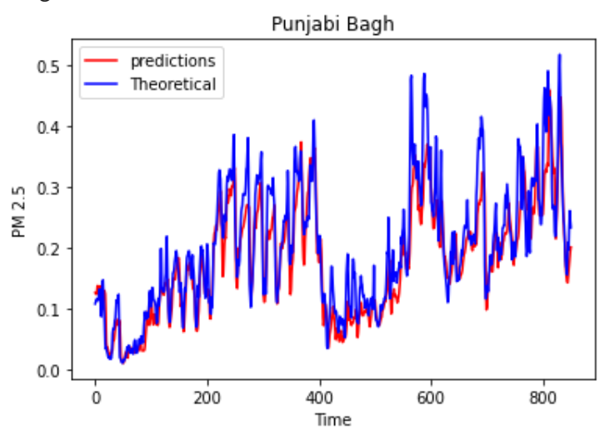
Results
Method | C-LSTME
ROOT MEAN SQUARE ERROR | 0.06268
MEAN ABSOLUTE ERROR | 0.04266
MEAN ABSOLUTE PERCENTAGE ERROR | 19.54

Slide 15
Methodology of C-LSTME
The input is a 3-D matrix contains normalized PM2.5 concentration data of dimensions k*N*r( k= n.o of neighbours ,N= n.o of stations ,r= The time lag ).
1st layer is a 3D convolution layer with the k*1*r convolution kernel ,
2nd layer is a activation layer were RELU is used as the activation function.
3rd stacked LSTM layer.
4th layer is a Fully connected layer .
The output is predicted PM2.5 concentration data.

Slide 16
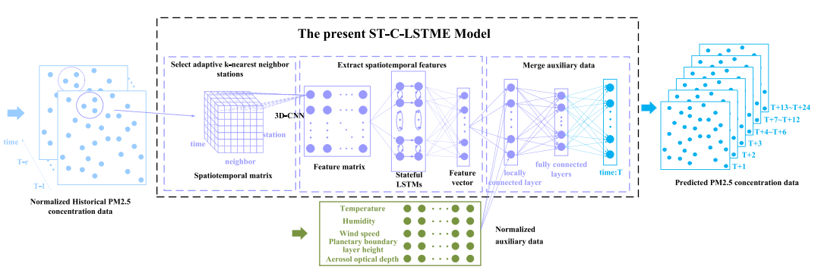
Network architecture C-LSTME Model
C - LSTME

Slide 17
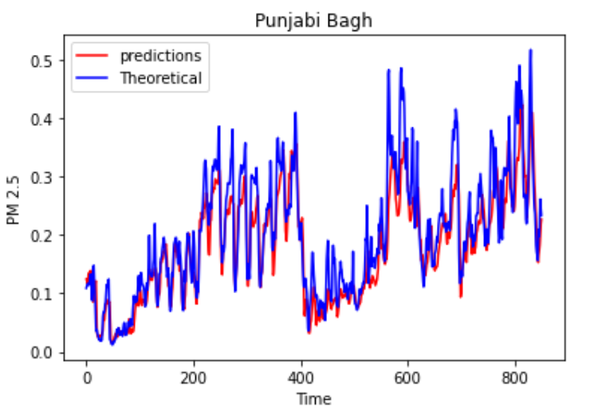
Results
Method | C-LSTME
ROOT MEAN SQUARE ERROR | 0.04606
MEAN ABSOLUTE ERROR | 0.03296
MEAN ABSOLUTE PERCENTAGE ERROR | 17.32

Slide 18
Comparison
LSTM Model:
Method | LSTME | C-LSTME
RSME | 0.06268 | 0.04606
MAE | 0.04266 | 0.03296
MAPE(%) | 19.54 | 17.32
C-LSTME Model:

Slide 19
Comparison
The addition of PM2.5 information from neighboring stations , which contributes to the spatiality of the data, can considerably improve the prediction accuracy of the model.
The C-LSTME model can efficiently extract more essential spatiotemporal correlation features through the combination of 3D-CNN and stateful LSTM, thereby yielding higher accuracy and stability for air quality prediction of different spatiotemporal scales.

Slide 20
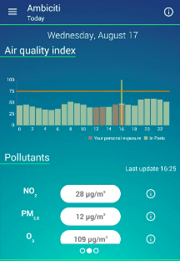
Model Front end design

Slide 21
Plan
3rd Quartile : Adding some optimization and regularization techniques to improve the accuracy of the C-LSTME model and working on the mobile application.
4th Quartile : Complecting Mobile application and finding comparison results in PM2.5 concentration before lockdown and during lockdown.

Slide 22
References
A novel spatio-temporal convolutional long short-term neural network for air pollution prediction. https://www.sciencedirect.com/science/article/pii/S0048969718344413
Air Pollution data ( Central Control Room for Air Quality Management ) https://app.cpcbccr.com/ccr/#/caaqm-dashboard-all/caaqm-landing/caaqm-comparison-data
J. Chen et al., 2014 https://www.sciencedirect.com/science/article/abs/pii/S1352231014003021

Slide 23
References continued..
Feng et al., 2011 https://www.sciencedirect.com/science/article/abs/pii/S135223101100029X
X li et al 2017 https://www.sciencedirect.com/science/article/pii/S0269749117307534
Soh et al. 2018 http://refhub.elsevier.com/S0048-9697(18)34441-3/rf0240

